Slide 1

Resource and Development: Understanding India's Natural Wealth
This presentation delves into the intricate relationship between resources and national development, with a specific focus on the Indian context. We will explore how our natural wealth, human capital, and sustainable practices are fundamental to fostering a prosperous and equitable future for all citizens of India.

Slide 2



What is a Resource?
At its core, a resource is anything from our environment that possesses utility and can satisfy human needs and wants. This broad definition encompasses a variety of elements essential for life and progress. Resources are categorised based on their origin, renewability, and how they are developed.
Natural Resources
Human Resources
Capital Resources
These are gifts of nature, including land, water, minerals, forests, and wildlife. They form the foundation of our economy and well-being.
Comprising the knowledge, skills, and labour of individuals. A skilled workforce is pivotal for innovating and transforming natural resources into useful products.
Man-made assets like machinery, infrastructure, and financial capital, crucial for the production and distribution of goods and services.
Understanding these classifications helps us manage and utilise them effectively for sustainable development.

Slide 3


Development and Resources: A Symbiotic Relationship
The trajectory of a nation's development is inextricably linked to its ability to effectively utilise its resources. However, this utilisation must be balanced with the imperative of sustainability. Sustainable development aims to meet the needs of the present generation without compromising the ability of future generations to meet their own needs.
Rio Earth Summit (1992)
Agenda 21
A landmark conference in Rio de Janeiro, Brazil, where world leaders formally committed to the principles of sustainable development and global environmental protection.
The comprehensive action plan adopted at the Rio Summit, outlining strategies for environmental protection and socio-economic development into the 21st century. It emphasised local, national, and global actions.
These global initiatives underscore the collective responsibility we bear towards fostering a sustainable future.

Slide 4
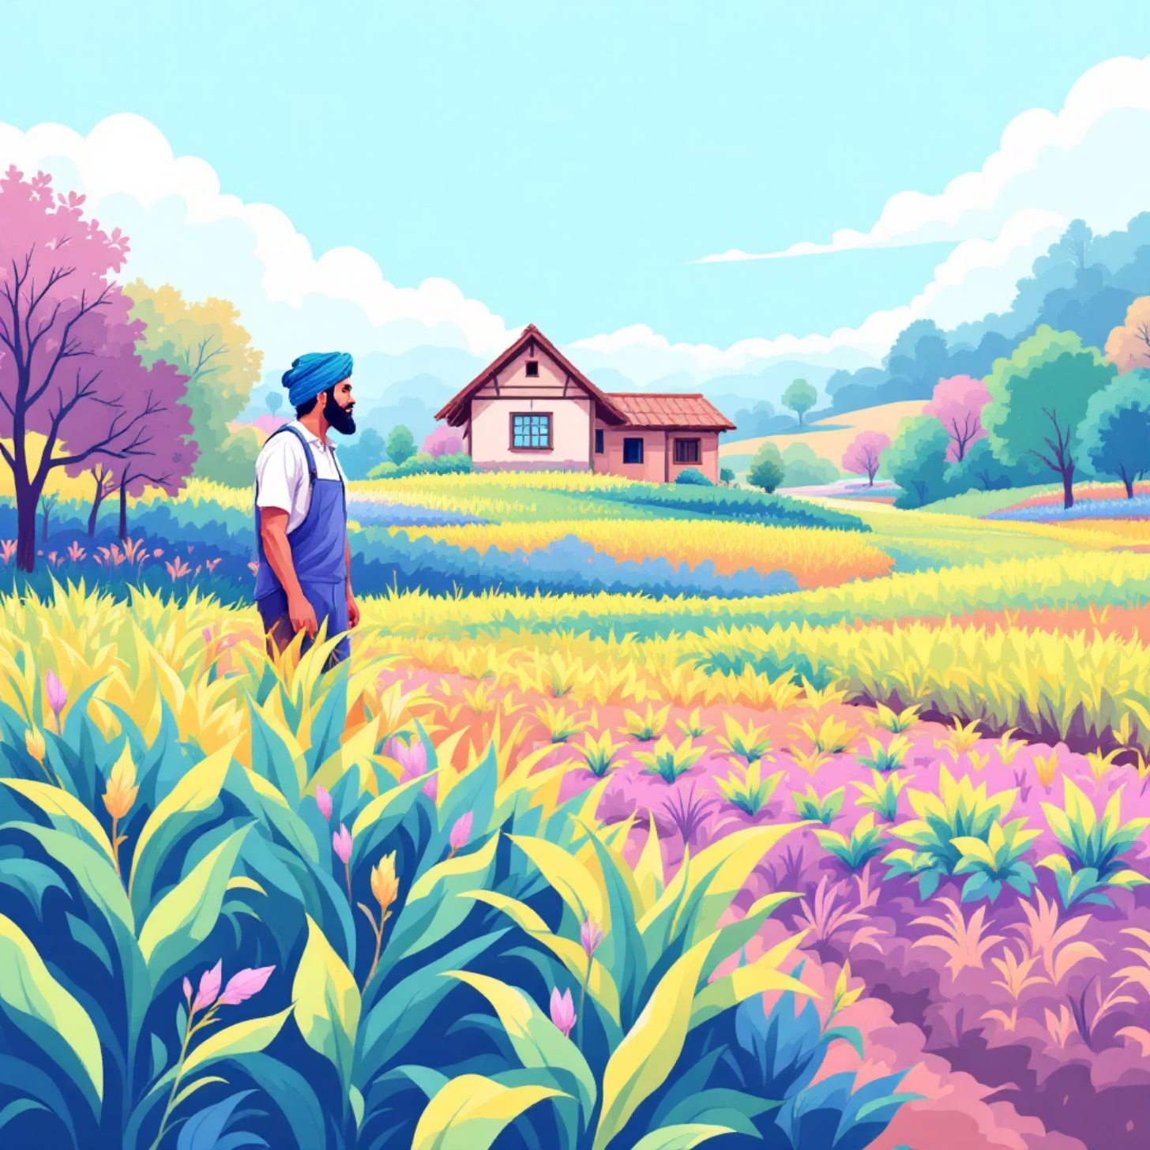
Resource Planning: The Indian Context
Resource planning is paramount for ensuring balanced economic growth and robust environmental protection. In India, a country with immense diversity and a large population, effective resource planning is crucial to optimise the utilisation of its vast land, water, mineral, and forest resources.
Challenges include significant population pressure.
Uneven distribution of resources across regions.
Pervasive resource degradation due to unsustainable practices.
The philosophy embodied in "Small is Beautiful" strongly advocates for local, community-driven sustainable resource management, aligning with India's diverse socio-economic fabric.

Slide 5
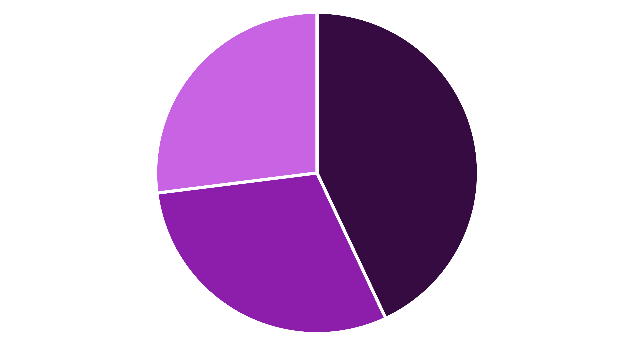
Land Resources of India: Distribution Overview
India's diverse topography plays a pivotal role in shaping its resource distribution and economic activities. The landforms – plains, mountains, and plateaus – each contribute uniquely to agriculture, settlement patterns, and the availability of various resources.
Plains
Mountains
Plateaus
The extensive plains are crucial for agriculture and dense population settlements, while the mountains provide forest wealth and perennial rivers. Plateaus, rich in mineral deposits, contribute significantly to industrial development across the nation.

Slide 6
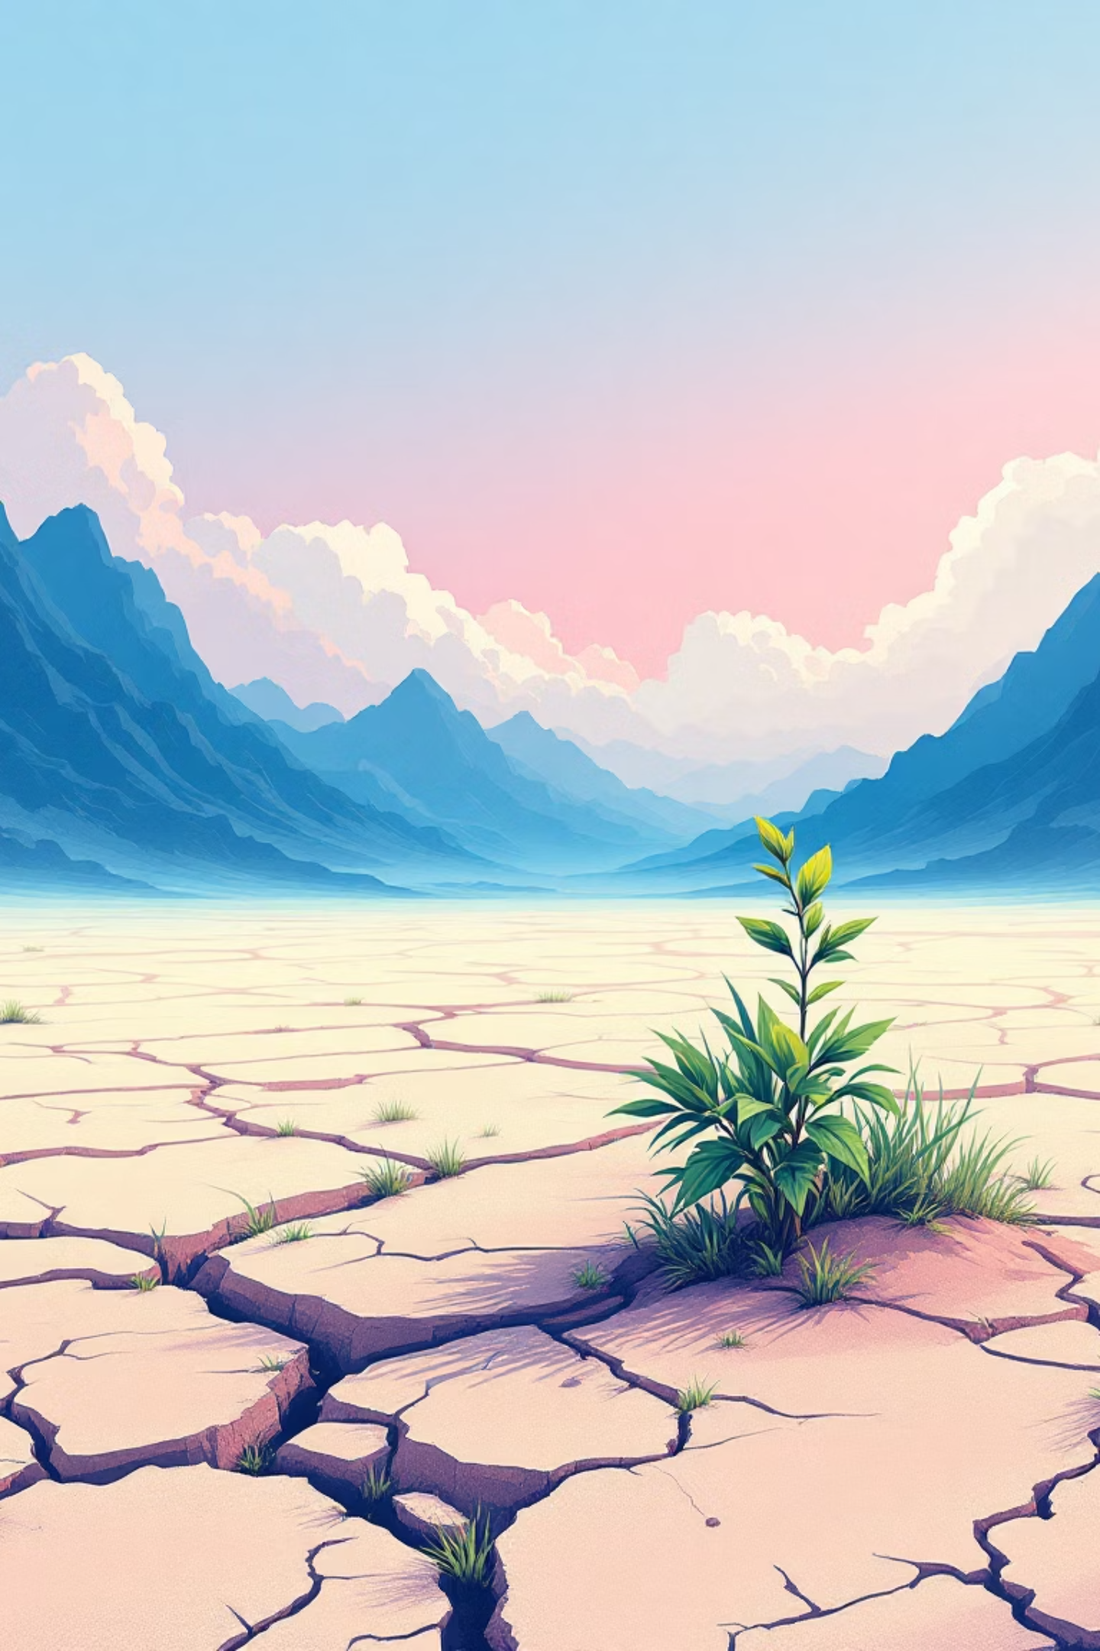
Land Degradation & Conservation Measures
Land degradation is a grave concern in India, impacting agricultural productivity and ecological balance. Major causes include extensive deforestation, unchecked overgrazing, intensive mining activities, and rapid, unplanned urbanisation. Annually, India suffers an alarming loss of approximately 5.3 billion tons of soil due to erosion.
Causes of Degradation
Deforestation & Tree Felling
Overgrazing by Livestock
Unsustainable Mining
Rapid Urban Expansion
Conservation Methods
Afforestation & Reforestation
Contour Ploughing on Slopes
Terracing & Bunding
Integrated Watershed Management
Government schemes like the National Watershed Development Project and MGNREGA actively support soil conservation efforts, aiming to restore degraded lands and promote sustainable land use practices.

Slide 7
Soil as a Resource: Classification & Importance
Soil is a dynamic natural body, forming the uppermost layer of the Earth's crust, essential for supporting life. It is not merely dirt but a complex living system classified based on its texture, colour, fertility, and geological origin. These diverse soil types underpin India's vast agricultural diversity.
Major Indian soil types include Alluvial soils (found in river plains, highly fertile), Black soils (rich in clay, ideal for cotton), Red and Yellow soils (found in Deccan plateau, often less fertile), Laterite soils (suitable for coffee/tea plantations), Arid/Desert soils (sandy, low moisture), and Forest/Mountain soils (varied, found in hilly regions). These soils are vital for agriculture, supporting biodiversity, and maintaining ecological balance.

Slide 8
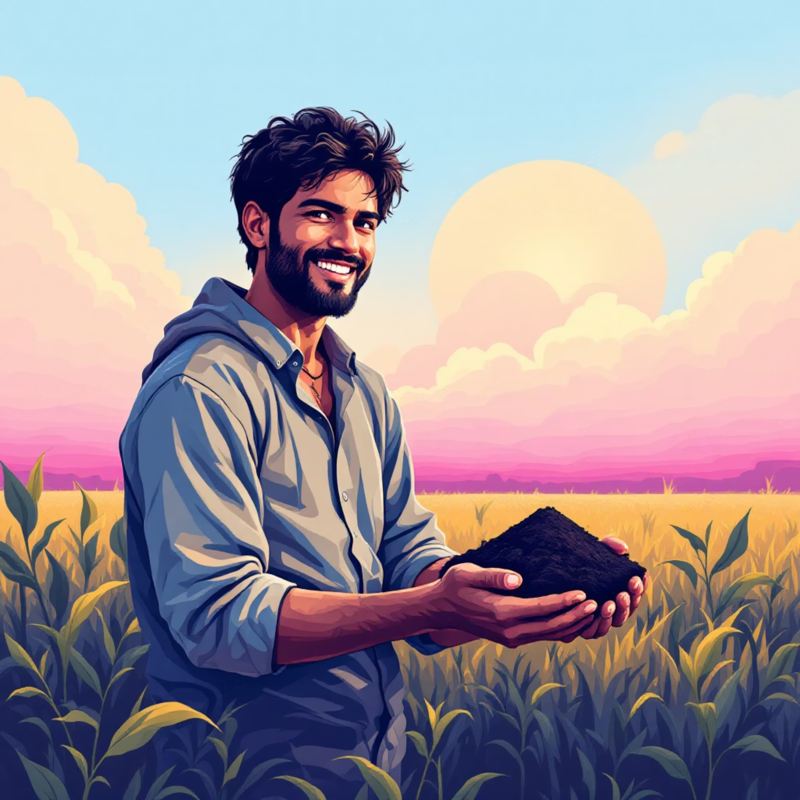
Soil Erosion & Soil Conservation in India
Soil erosion, primarily caused by water and wind, remains a significant threat to India’s land resources. Approximately 37% of India's total land area is affected by various forms of degradation, impacting food security and livelihoods. Urgent measures are needed to mitigate this environmental challenge.
Promote Organic Farming
Adopting chemical-free cultivation practices to preserve soil fertility and biodiversity.
The Soil Health Card Scheme is a key government initiative providing farmers with vital information on their soil's nutrient status, advising them on balanced fertiliser application to reduce chemical overuse and improve soil health.
Mulching
Covering soil with organic material to retain moisture, suppress weeds, and prevent erosion.
Crop Rotation
Alternating different crops on the same land to maintain soil nutrient levels and break pest cycles.
Agroforestry
Integrating trees and shrubs into agricultural landscapes to enhance ecological stability and productivity.
Local bodies, especially Panchayats, play a crucial role in implementing these conservation efforts at the grassroots level, fostering community participation.

Slide 9








Sustainable Development & Resource Management
Sustainable development is the strategic integration of economic growth with environmental protection. This approach prioritises the efficient use of renewable resources and significantly reducing the reliance on harmful chemical inputs in agriculture and industry.
Eco-Friendly Growth
Renewable Energy Focus
Balancing industrial growth with minimal environmental footprint, ensuring long-term ecological health.
Shifting towards solar, wind, and hydro power to reduce carbon emissions and conserve finite fossil fuels.
Global & Local Action
Organic Farming Surge
Success hinges on robust international cooperation complemented by strong local initiatives and community engagement.
India's organic farming area increased to 2.7% by 2022, reflecting a growing awareness and commitment to sustainable agriculture.
India's journey towards sustainability is marked by increasing adoption of green technologies and a greater public awareness about environmental conservation, showcasing a path for holistic progress.

Slide 10
Conclusion: Our Responsibility for Future Generations
The judicious and wise utilisation of resources is not just an economic imperative but a moral responsibility for India’s sustainable growth. Soil and water conservation stand as fundamental pillars, ensuring both food security for our burgeoning population and the long-term ecological health of our diverse landscapes.
"The Earth provides enough to satisfy every man's needs, but not every man's greed."
- Mahatma Gandhi
It demands collective action — from governmental policies and community-led initiatives to individual conscientious choices. Embracing the philosophy of "Small is Beautiful" reminds us that local, thoughtful solutions can collectively address even the most formidable global challenges. Let us commit to being stewards of our planet for the generations to come.

